Slide 1


PERSONAL
PORTFOLIO
C.B. Williams

Slide 2

Dear Home Seller:
My enclosed Marketing Proposal is designed to give you a chance to know a little bit about the step-by-step plan we use to get Sellers the MOST NET in the LEAST AMOUNT of TIME with the LEAST STRESS.
The information on the following pages is designed to give you an overview of exactly what it takes to sell any home in today's ever-changing marketplace. It is no longer enough to put a for sale sign in the yard and hope someone will see it and want to buy it.
When we meet, you can expect me to be a candid, up-front, no-nonsense, professional. There are lots of opinions but just one set of facts. We’ll look at the facts of record to determine the best pricing strategy to use that assures your home sells for the highest possible NET. The final pricing strategy is subject to your approval.
80% of the marketing on your home is done when the pricing strategy for your home is selected. This Proposal contains detailed information on this issue to assist you in making an informed decision. Be assured, our job is to sell your home for the most money possible, not the least.
Most Sincerely,
C.B. Williams
Real Estate Done Right!

Slide 3
BEFORE YOU READ THIS...
I URGE YOU TO CALL AT LEAST 3 OF THESE REFERENCES ATTACHED.
In order for you to fully understand and appreciate the information in front of you and the person who is giving it to you I would ask just one thing of you first.
Please take the time to call at least 3 of my clients and ask them the following questions:
Did you hire C.B. Williams to Sell Your Home?
Did he get you the MOST NET in the LEAST amount
of time?
3) How would you rate his overall knowledge, expertise
and service?
4) Would you use him again? Why?

Slide 4


Current References

Slide 5

A Seller’s Guide
to interviewing a Real Estate Agent
to sell your property.
There are thousands of real estate licensees in our area. Choosing
the right agent for your home can be confusing. It is especially
difficult when you speak with several different agents, and they all
seem so convincing.
There is a way to determine who is the most likely to succeed
in getting your price and terms. The key is knowing the right
questions to ask. This is particularly important now, as homes are
selling more quickly.
The following list provides you with questions to ask each
Prospective Realtor. You should ask me these questions as well.
The answers to these questions will tell you what you need to
know in order to make the decision that is best for you.
1) Do you work as a full-time REALTOR®? How many years have you been licensed to sell real estate full-time in Florida?
2) Do you GUARANTEE your services?
3) May I cancel my listing with you at anytime if I am not satisfied with your performance?
4) Why should I list with you?

Slide 6
A Seller's Guide
continued
5) Do you have a system to follow-up so that we get valuable feedback after every showing?
6) How many properties have you sold within the past 6 months? 30 days? 90 days?
7) Do you have references that I may check? (Sellers who are currently listed with you)
8) Do you have an Internet Strategy that includes Social Networking and Syndication to expose and promote my home 24-7?
9) What is my property worth? What listing price do you recommend? Will it sell at that price?
10) Will you GUARANTEE my home will sell for the price you suggest to list it at?
12) Do you have a written Specific Marketing Plan
designed to sell my property quickly and for top dollar?
  13) What is the single most valuable service you provide to a home seller just like me?

Slide 7





The Market Types
There are three types of overall market conditions when selling your home. They are:
Seller's Market - This is when the inventory in a specific area is low. Properly priced homes generally sell within 14 days to 21 days maximum. If your property has not received an offer within this time period, it is priced too high.
Normal Market - This is when there is no real perceived advantage to either the buyers or the sellers. Properly priced homes should sell within 30 to 45 days.
Buyer's Market - This is when you have lots of homes on the market for sale in every price range and area. If you price your home just below the other similar homes on the market a sale should result within 60-90 days. Usually, homes are declining in value in this type of market. Therefore, the sooner you sell, the better it is for you.

Slide 8

Revealing Research...
The National Association of Realtors researched the history of homes that actually sold in all three types of markets and they discovered two critical pieces of information:
1. 95% of all homes that closed escrow sold within 60 days after the listing price (seller's asking price) was set at the appropriate market price.
2. Homes properly priced sold within 3% of the seller's asking price.
Therefore, if a property has not received an offer within 60 days, it is overpriced by at least 5% to 10% and possibly more.

Slide 9

Time is of the Essence
The majority of buyer activity on a new listing occurs in the first two to three weeks of the initial marketing period.
For this reason, it is important that you have your home in the...
BEST CONDITION
and at the
RIGHT-PRICE
for the
FIRST EXPOSURE
to the market

Slide 10

Three Possible Pricing ‘Strategies’
"As Is" Pricing Strategy
The property is SOLD without benefit of any repair work paid for by the Seller that is either required or recommended in any inspection reports.
Buyer may have any and all inspections deemed necessary to satisfy themselves as to the condition of the property. These inspections will be paid for by the Home Buyer!
A Strategy such as this is used when the Seller is either in a Short Sale Situation, has little to no equity or no urgency to sell.

Slide 11

Another Pricing Strategy
Is the…
“Quick Sale” Pricing Strategy
This strategy is almost always effective because when a property is priced at or below the current market, it will usually sell quickly.
This pricing strategy makes it much easier for me to get the attention of other agents in our area. As a result there are numerous showings. Which then generates one or more offers coming from agents that wait for properly priced homes to show to their BEST Clients.
This is, by far, the most effective strategy to get your home SOLD FAST and for the highest realistic price the market will bear.

Slide 12
And Still Another Pricing
Strategy is the
"Traditional" Pricing Strategy
This strategy is called TRADITIONAL because it calls for doing all of the standard activities that eventually lead to a sale on your home…
Such as obtaining the proper Inspections and completing all necessary repairs called for before the home is placed on the general market, getting a Pre-Sale Appraisal etc…
The agent is following the series of actions called for in their marketing plan. Basically, by implementing numerous marketing activities designed to create a demand for someone to want to buy your home.
Note: If you do not have an offer within 14-40 days, the property is priced too high and is in need of a price enhancement. It is essential that automatic price adjustments occur to maintain marketing momentum. Usually, a price adjustment of 5% to 10% at the end of 14 days will result in a sale shortly thereafter.

Slide 13

Who Determines the Market Value of My Home?
The Real Market Value of Your Home is Determined When Someone Tells us What They are Willing to Pay For Your Home, You Decide to Accept that Price and Escrow Closes!
That may sound odd I know but until this event happens the determining market value is really a matter of making an educated guess.
Are You Kidding, You Guess?
There are lot’s of opinions yet only one set of facts. We will examine the Facts of Record and together we will determine a PRICING STRATEGY designed to sell your home for the most NET.
No One Can Tell me What my Home Will Sell For?
Not really. Someone might tell you a figure but no one knows the market value of your home because it is not established until someone buys it for a specific price. That’s why we use facts of record to determine a pricing strategy.

Slide 14
How Do We Determine
Which Pricing Strategy is Best for Selling Our Home?
As I said before, there are lots of opinions but only one set of facts. Together, we will examine the facts of record to determine the most effective pricing strategy to obtain the maximum price possible for you.
Our ‘Total Market Overview’ examines 3 things:
1. Similar Homes Recently Sold
Tells us what buyers are willing to pay for this kind of home, in this area, at this time.
2. Similar Homes Now For Sale
Tells us about our competition. Buyers will compare your home to these homes.
3. Expired Listings
Tells us what buyers are not willing to pay for this kind of home, in this area, at this time.

Slide 15



of the Marketing of Your Home is Accomplished Using a Pricing Strategy Based on Facts!
1. Getting Top Dollar for Your Home
A ‘Total Market Overview’ will assist us in determining a pricing strategy that leads to a sale.
2. Mobilizing the Agent Community
Agents will want to show your home to their buyers since a proper pricing strategy was used.
3. Buyers Are Anxious to See Your Home
Many Agents have several buyers that are ready-to-buy. They are simply waiting for a new listing that is priced properly..
4. TOTAL MARKETING OVERVIEW
Using the Total Market Overview allows us to position your home to maximize our professional marketing strategies..
Remember, Our Job Is To Sell Your Home For The MOST NET, Not The Least!

Slide 16


THINKING ABOUT SELLING?
Prior to meeting with me, please fill out this quick survey. Tell me what concerns you most about selling your home and hiring a real estate agent.
That way when we meet we will discuss only those things that are MOST IMPORTANT to you. Our meeting will take about 20-25 minutes unless you have more questions.
WHAT ARE YOU CONCERNED ABOUT?
NOT CONCERNED VERY CONCERNED
LENGTHY LISTING PERIOD? 1 2 3 4
NET? 1 2 3 4
BROKER COMMISSION? 1 2 3 4
INCONVENIENCE? 1 2 3 4
ADVERTISING? 1 2 3 4
OPEN HOUSES? 1 2 3 4
WRONG AGENT? 1 2 3 4
INTERNET? 1 2 3 4
PRICING STRATEGY? 1 2 3 4
MARKETING SYSTEM? 1 2 3 4
SECURITY? 1 2 3 4
TIME IT TAKES TO SELL? 1 2 3 4
CLOSING ESCROW? 1 2 3 4
Home Work Page

Slide 17

There's No Place Like Home.
Tell Me Why Your Home Is Special
We're sure you have enjoyed living in your home and have been pleased with its many features. I can make sure we tell prospective buyers about all the special features of your home. Please fill in the items below so I can target our marketing efforts to those prospects most likely to buy your home.
Home Work Page
Home features that we have really enjoyed:________________________
______________________________________________________________
______________________________________________________________
Things about this house we will miss most:_________________________
______________________________________________________________
______________________________________________________________
______________________________________________________________
How would you describe your home to a buyer :_____________________
______________________________________________________________
______________________________________________________________
Your Name:___________________________________________________
Address:______________________________________________________
City:____________________________State:________Zip:_____________
Thank you for your cooperation.
C.B. Williams

Slide 18



Slide 19

Today's real estate market presents unexpected obstacles and opportunities. Many agents often find themselves at a loss when confronting present day conditions.
That's because the business climate now requires knowledgeable trouble-shooting performed with surgical precision; something most agents just aren't equipped to do. C.B. Williams will focus his expertise on each challenge. A professional who is among the market's most experienced and successful Brokers. His work is backed by a successful firm of knowledgeable professionals tapping unique resources online and offline.
C.B. Williams has been helping buyers and sellers for almost 40 years. Isn't it your turn to have the BEST?
C.B. has the desire to serve,
The tools to perform,
and the confidence to succeed.
Make your choice
C.B. Williams

Slide 20

You Get a Full-Time
Professional Agent
You won't find ANYONE
who will work HARDER
or more PROFESSIONALLY
to get you the MOST NET,
the QUICKEST sale and the
FEWEST problems.

Slide 21

Right Now Serious Buyers Go to a Realtor® . . .
Because 88% Of The Homes For Sale…
are Listed By A REALTOR®.

Slide 22
On The Average . . .
Buyers Inspect 12
Homes on average Before
Deciding.
That Means 11 Other Homes Are Competing
Against Yours!

Slide 23
We Love A Challenge!
We Know How to Position Your Property to Get it Sold!

Slide 24

My Marketing System is
Designed To…..
TARGET & ATTRACT
QUALIFIED & SERIOUS
HOME BUYERS.
Not Those Who Will Only BUY If They Can Steal Your Home By Making Ridiculous Low-ball Offers!

Slide 25
WHY YOU SHOULD PRICE YOUR HOME REALISTICALLY
TIME
Chances are that your home will sell at its fair market value. Pricing it
realistically at the outset simply increases the likelihood of a timely sale
with less inconvenience and greater monetary return.
COMPETITION
Buyers educate themselves by viewing many homes. They know what is a fair price. If your home is not competitive in value with those they have seen, it will not sell. Buyers typically look at homes within a $50,000 price range (e.g. $150,000 - $200,000). If your home is not priced within the correct range, it very likely will not be exposed to its potential or targeted buyers.
REPUTATION
Overpricing causes most homes to remain on the market too long. Buyers, aware of a long exposure period, are often hesitant to make
an offer because they fear "something is wrong" with the house.
Often homes that are on the market for a long time eventually sell
for less than their fair market value.
INCONVENIENCE
If overpricing keeps your home from selling promptly, you can end up
owning two homes -- the one you've already purchased and the one you're trying to sell. This can prove costly and worrisome, as well as inconvenient.
80% OF THE MARKETING OF YOUR HOME IS DONE THE NIGHT WE DECIDE AT WHAT PRICE WE WILL LIST YOUR HOME.

Slide 26

Three Ways I Will Expose Your Home To The Greatest
Number of Potential Buyers
Agent to Agent email and direct marketing designed to mobilize the entire real estate community to get them to show and sell your home.
Using cutting-edge technology and 24 hr. marketing both online and off, we expose your home to enough potential home buyers and Realtors that it SELLS!
We create a website just for your home. We use dozens of high impact photos, a virtual tour, unique verbiage then link it to hundreds of the most visited home buyer websites and social media locations.

Slide 27

I PRE-APPROVE
EVERY PROSPECT. . .
Some are in a hurry to move.
Some are serious but not in a hurry.
Some are bargain hunters.
Some will never buy.
I can save you from having unqualified "strangers" wandering through your home.

Slide 28
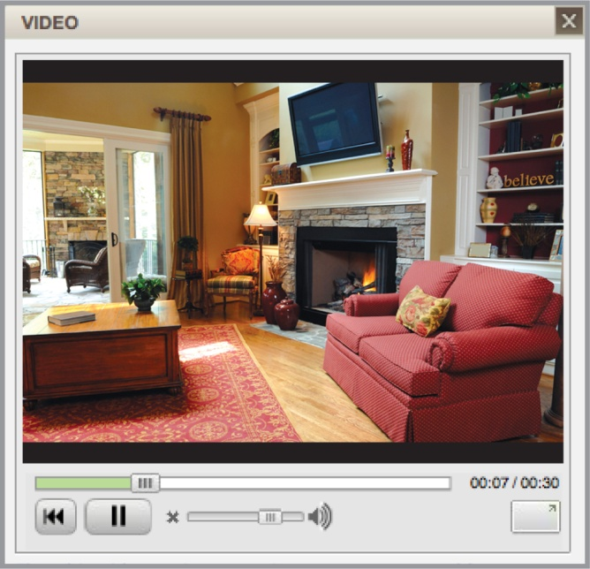
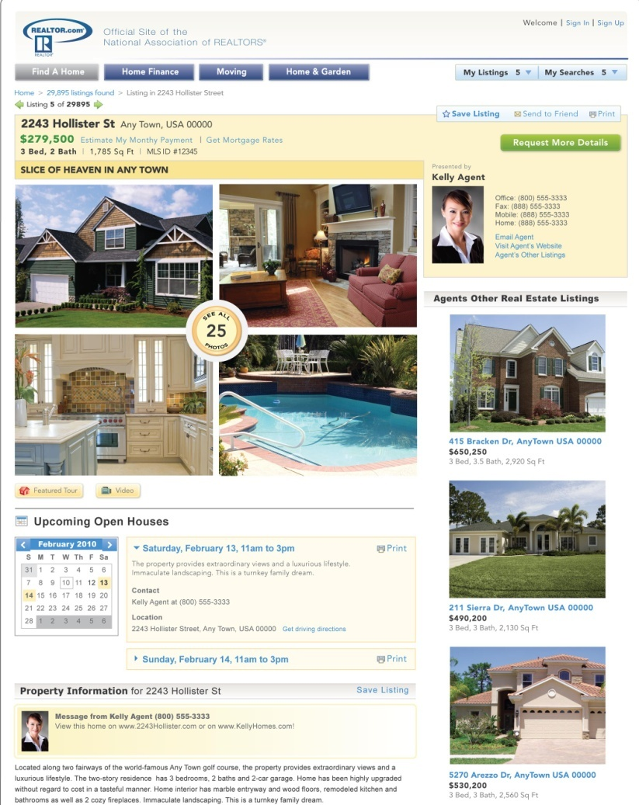
HOW WILL I SHOWCASE YOUR HOME
TO THE MOST BUYERS?
    Virtual Tour Marketing
Over 100 million Americans watch videos on the internet every month
I will make
your home
“stand out”
with a video
or virtual tour!
Virtual Home Tours can be viewed by home buyers anywhere in the world via computer.

Slide 29
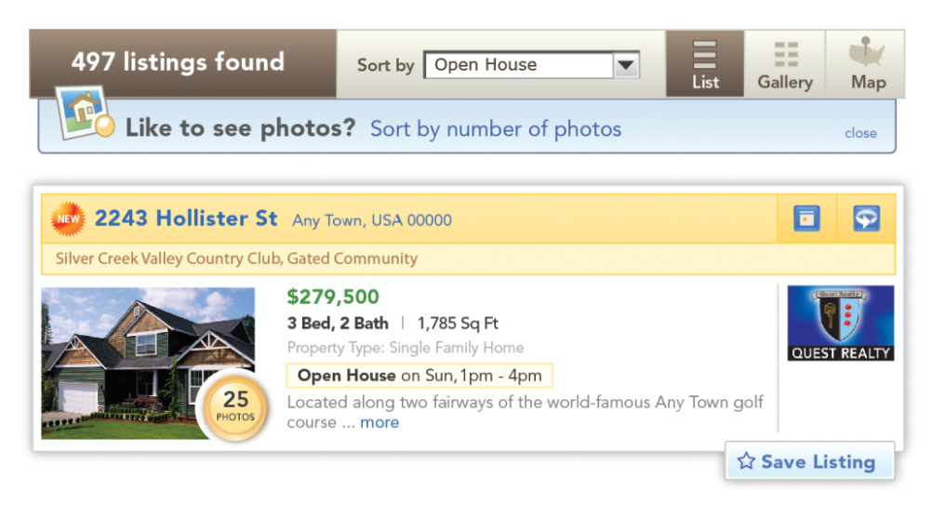

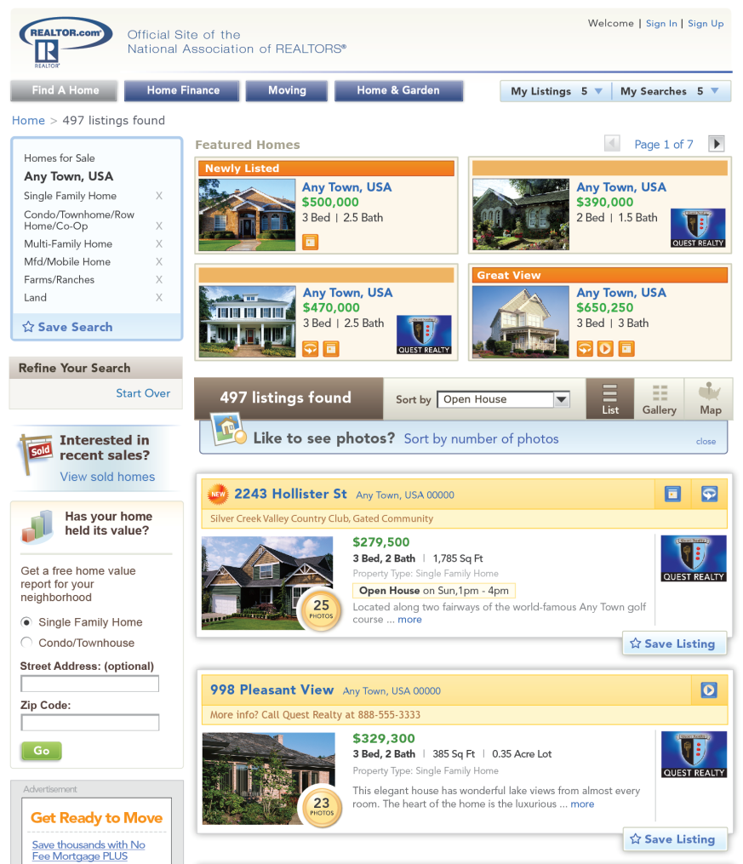
‘ENHANCED LISTINGS’
ANOTHER METHOD FOR “MAXIMUM EXPOSURE”!
Enable your home to rise to the top of the search above all other homes by adding more photos
Enhanced listings allow up to 25 photos
BENEFIT: You get “Maximum Exposure” which means more and more potential Buyers are aware your home is for sale. More exposure equals quicker sale for you!

Slide 30

Introducing Our
24 / 7 / 365
Marketing System!
Your home on the Internet - not just on any old site but on
hundreds of sites that are high-tech and interactive. Aggressive
marketing and advertising then direct buyers to these websites.
(Just having your home on a website is not enough.)
Always giving the consumer necessary information: home address, area, number of bedrooms, baths, square footage,
etc. This information is always easy to obtain.
Virtual home tours - provide an exciting method for home buyers to tour a home without having to leave their living
room or office.
5. Marketing your home where it is seen by the consumer and then making the information easily obtainable.

Slide 31

The Fact Of the Matter Is:
PRICE FACT THE BEST CHANCE FOR SELLING YOUR PROPERTY IS WITHIN THE FIRST SEVEN WEEKS. STUDIES SHOW THAT THE LONGER A PROPERTY STAYS ON THE MARKET, THE LESS THE SELLER WILL NET.
It is very important to price your property at a competitive market value at the signing of the listing agreement. The market is so competitive that even over-pricing by a few thousand dollars could mean that your house will not sell. Interestingly, your first offer is usually your best offer. Here are reasons for pricing your property at the market value right from the start in order to net you the most amount of money in the shortest amount on time.
An overpriced home: Lowers agent response
Lowers prospects
Limits qualified buyers
Limits Showings
Minimizes offers
Limits Financing
Nets Less for the seller
CLEAN FACT : MOST PEOPLE ARE TURNED OFF BY EVEN THE SMALLEST
AMOUNT OF UNCLEANLINESS OR ODOR WHEN BUYING A HOME.
SELLERS LOSE THOUSANDS OF DOLLARS BECAUSE THEY DO
NOT ADEQUATELY CLEAN.
If your house is squeaky clean, you will be able to sell your home faster and net hundreds, if not thousands, of dollars more. If you are planning on moving, why not get rid of that old junk now so that your house will appear larger and more spacious? Odors must be eliminated especially if you have dogs, cats, or young children in diapers or if you are a smoker. You may not notice the smell, but buyers do!

Slide 32
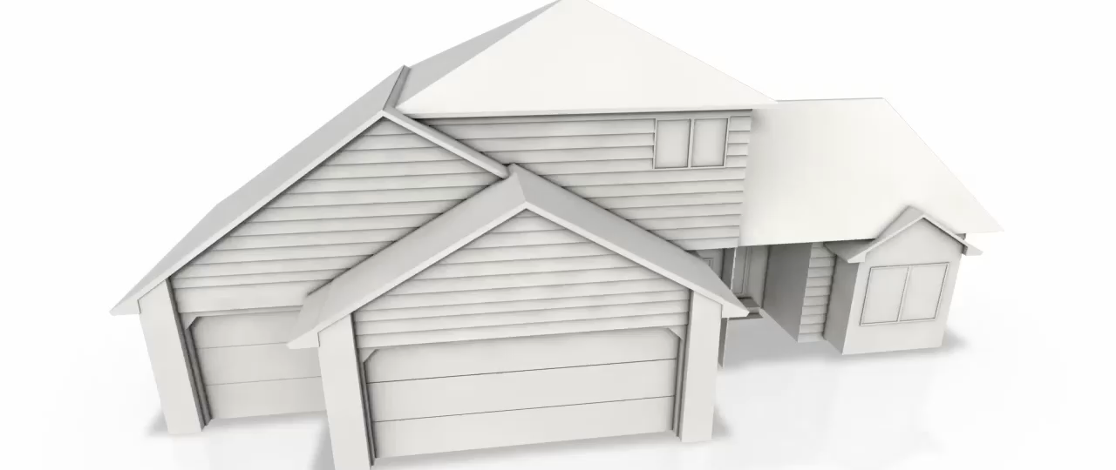
To Get Your Home SOLD…
Schedule an Appointment to
Get Your Home SOLD,
Talk to C.B.
813-xxx-xxxx
A face-to-face meeting with C.B. will
only take 10-25 minutes...it will
only take longer if you have
more questions.

